Slide 1
Objective
This project aims to predict customer churn using historical telecom usage data. Early identification of customers at risk of leaving allows the company to design targeted retention campaigns and reduce revenue loss.
The objective is to develop a predictive model that accurately identifies customers likely to churn, and to uncover key factors influencing churn behaviour.

Slide 2
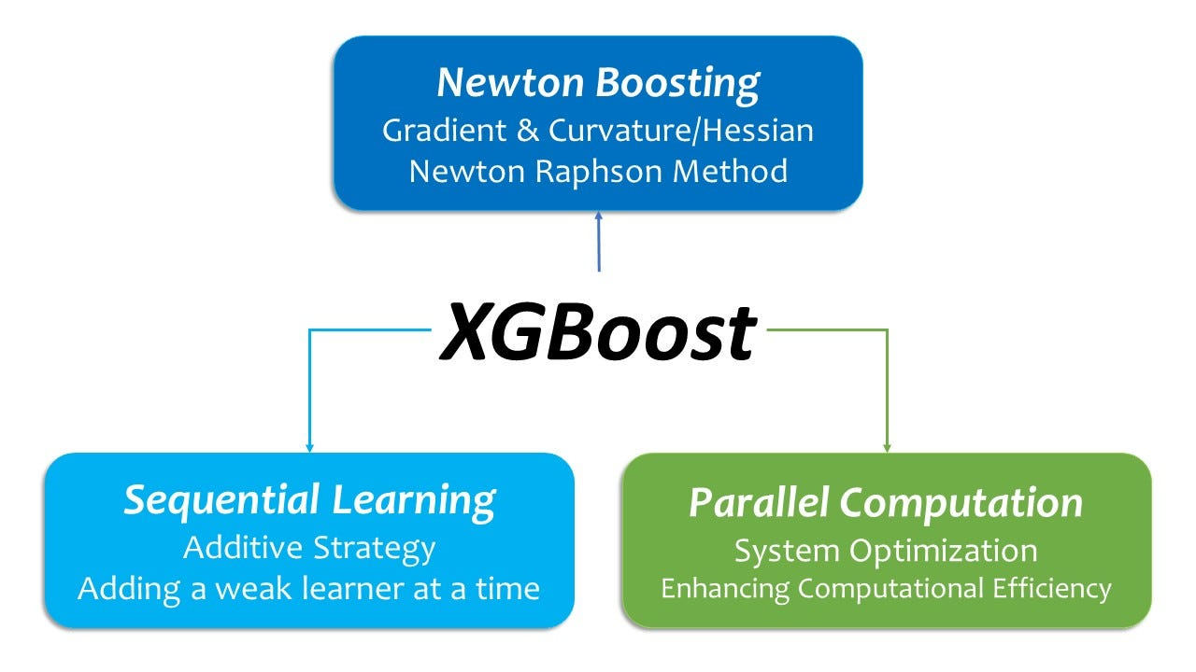
XGBoost
XGBoost (Extreme Gradient Boosting) optimized machine learning library that uses an advanced form of gradient boosting to solve supervised learning problems like classification and regression.
This was employed over other predictive models such as Random Forest due to its robustness, ability to handle mixed data types, and effectiveness with imbalanced classification tasks.

Slide 3
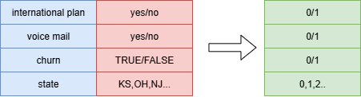
Feature Selection/Data Cleaning
New features were added (e.g Total call duration, cost per minute)
Existing features required encoding before they can be categorised by XGBoost

Slide 4
Evaluation
Table 1 Evaluation Results
Based on quantitative metrics, model was shown to be able to correctly predict the majority of customer outcomes, distinguish churn and detect at-risk customers of that are leaving
Metric | Value | Analysis
Accuracy | 0.9535 | Overall 95% correct predictions
AUC | 0.9046 | Strong ability to separate churners vs non-churners
F1 | 0.83 | Balanced performance for churn prediction
Recall | 0.79 | 79% of actual churners detected

Slide 5
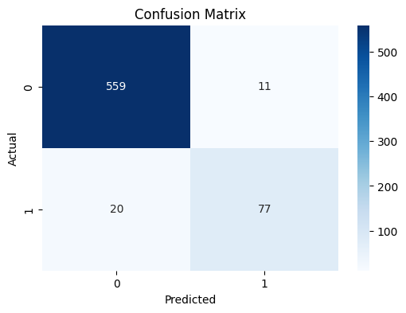
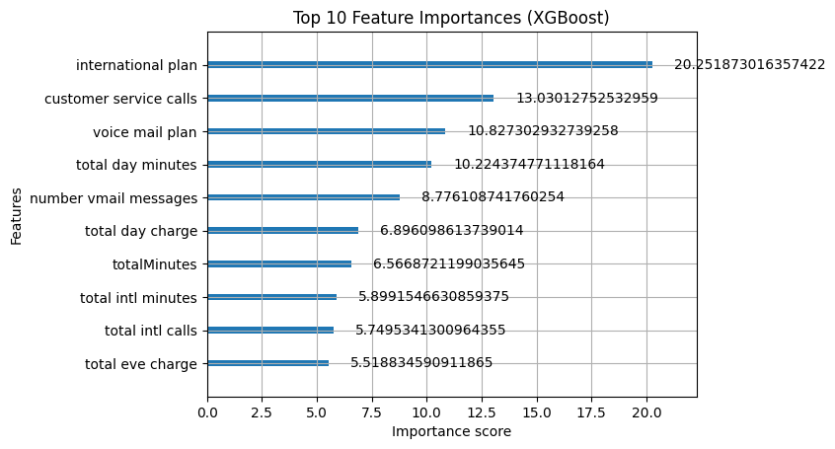
Evaluation 2
International Callers and Frequent Customer Service Centre callers were strong indicators
Strong Performance in identifying churn

Slide 6
Recommendations
Review and redesign international plans, improve transparency around costs, and introduce loyalty incentives or bundle offers for these customers. Targeted retention campaigns focusing on this high-risk group could substantially reduce overall churn.
Implement early-warning systems to identify and address these customers’ pain points could prevent churn before it occurs.

Slide 7
Ethics Considerations
Fairness - model does not unfairly target customers from specific regions or demographics
Privacy – remove sensitive customer information, such as phone numbers, to maintain confidentiality.
Responsible use - ensuring that predictions are used to assist customer service teams rather than to penalise users

Slide 8
Conclusion
The XGBoost churn model achieved AUC = 0.90 and F1 = 0.83, indicating strong predictive performance.
Key churn drivers include customer service interactions and frequent international callers.
With proper governance, the model can support data-driven retention strategies while maintaining ethical standards.

